Slide 1


Complexity Question Detection Intermediate presentation
Author: Andrada-Ioana Cojocaru
Thesis advisor: Ș.L.dr.ing. Ștefan Rușeți
BUCHAREST​ 2024​
University Politehnica of Bucharest

Slide 2
Table of contents
01
02
03
Topic
Results
Conclusions
Presentation on this subject in general.
The results obtained.
The conclusions of the project.

Slide 3
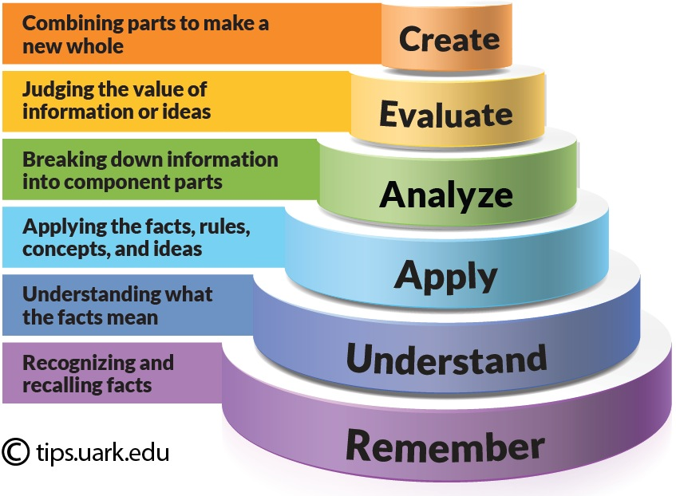
01
Complexity Question Detection using Bloom’s Taxonomy
Problem
Detect the complexity of a question using the categories of Blooms taxonomy.
Solution
Create a classificator using LLM and prompt engineering techniques to obtain the best results, using the EduQG dataset, that only contains data from 4 categories - "Knowledge", "Comprehension", "Application", "Analysis" .

Slide 4
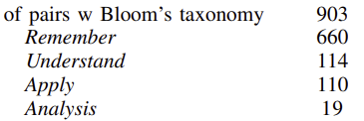
Results 1
02
Models
List with verbs specific for every category
llama3.1:3b
llama3.2:70b
qwen2.5:1.5b
qwen2.5:1.32b
qwen2.5:1.72b
F1 score = 0.6289
Set de date - EduQG
3,397 multiple-choice questions, not every has the bloom tacxonomy classification - unbalanced
Labeled manually for cognitive complexity based on Bloom’s Taxonomy.
Best result
llama3.1:70b F1 score = 0.6580

Slide 5
Results 2
02
Models
Ideas
BERT based uncased
BERT large uncased epochs – 3
Batch size – 64 Optuna – hyperparameter optimization on BERT F1 scores DistilBERT - 0.45
ROBERTA – 0.37
3 epochs LSTM – 0.45 GRU – 0.34 5 epochs
- Split train test 80 20 BERT F1 score 0.8282 accuracy 0.70 -> every question was classified as Knowledge - changed the train test for more data for training and select 5% data for test to have from every question type and balanced now BERT f1 – 0.67 - Computed based on the class distribution and normalized for balanced training

Slide 6
Conclusions
03
The dataset EduQG is small and has unbalanced data for the 4 Bloom classes, more than 70% Remember.
We tried to compute based on the class distribution and normalized for balanced training, but the model did not learn the classification correctly
We tried different models: BERT, ROBERTA, DistilBERT, LSTM, GRU with different parameters, nothing worked as expected.

Slide 7
Thanks!
Do you have any questions?
andrada.cojocaru@stud.acs.upb.ro

